Slide 1

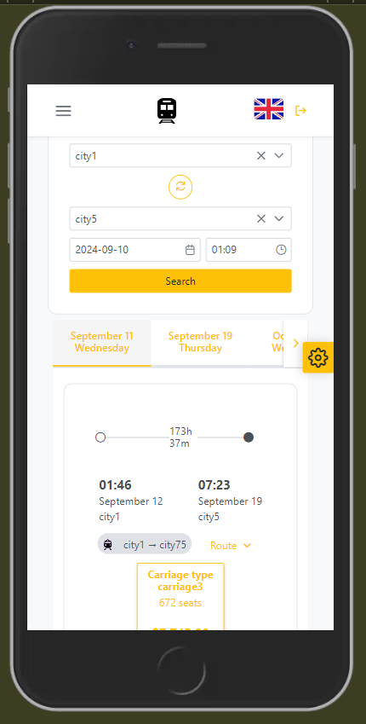

Express Train App
Notes:
AUTHOR: TATSIANA
TEXT:
Hello, everyone! Welcome to the presentation of our new app for international train travel: Express Train App.

Slide 2

Team Member Contributions
Lionna
Trouvere
DmitaN
Role: Lead
Developer
Role: Senior
Developer
Role: Tech Lead
Notes:
AUTHOR: TATSIANA
TEXT:
First, let's introduce the members of our development team:
DmitaN, also known as Alexander, is our Tech Lead who has been instrumental in solving the project's technical challenges.
Trouvere, or Alexey, is our Senior Frontend Developer. He focused on resolving issues related to NgRx, Lazy loading and the visual representation of data.
Lionna, or Tatiana, is our Team Lead Developer who managed the entire process of software development and testing.

Slide 3
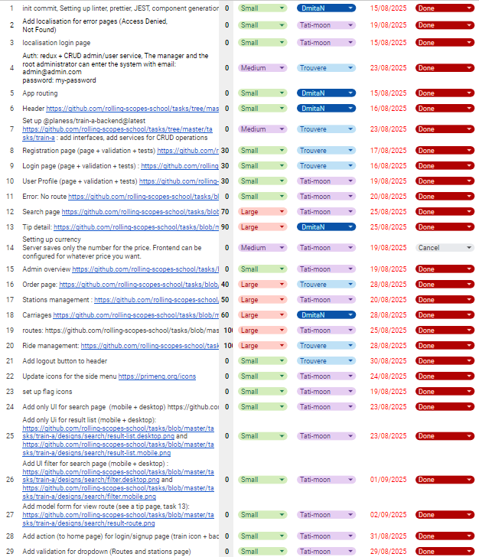
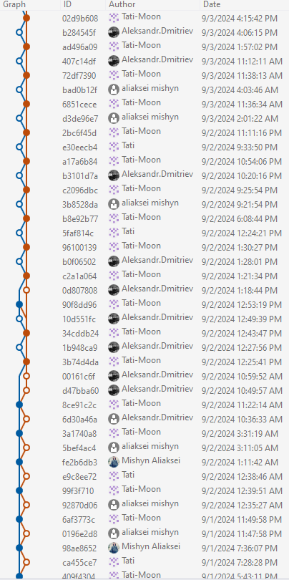




Teamwork
1.Task Management
We used a shared Google Excel file to register tasks, set priorities, assign team members, and estimate the completion times.
2. Discussions
All discussions and quick communication were managed in a dedicated Discord channel.
3. Meetings
We held regular meetings on Google Meet every few days to discuss progress, address issues, and plan upcoming tasks.
4. Code Collaboration
All code contributions were made through pull requests on GitHub, followed by thorough code reviews to maintain quality and ensure consistency across the project.
Notes:
AUTHOR: TATSIANA
TEXT:
All task descriptions were compiled into an Excel file where I outlined the task scope, estimated time, and the task status (done, in progress, open, closed).
All discussions were held in our dedicated Discord channel.We held regular meetings on Google Meet every few days to discuss progress, address issues, and plan upcoming tasks.
All code contributions were made through pull requests on GitHub, followed by thorough code reviews to maintain quality and ensure consistency across the project.

Slide 4
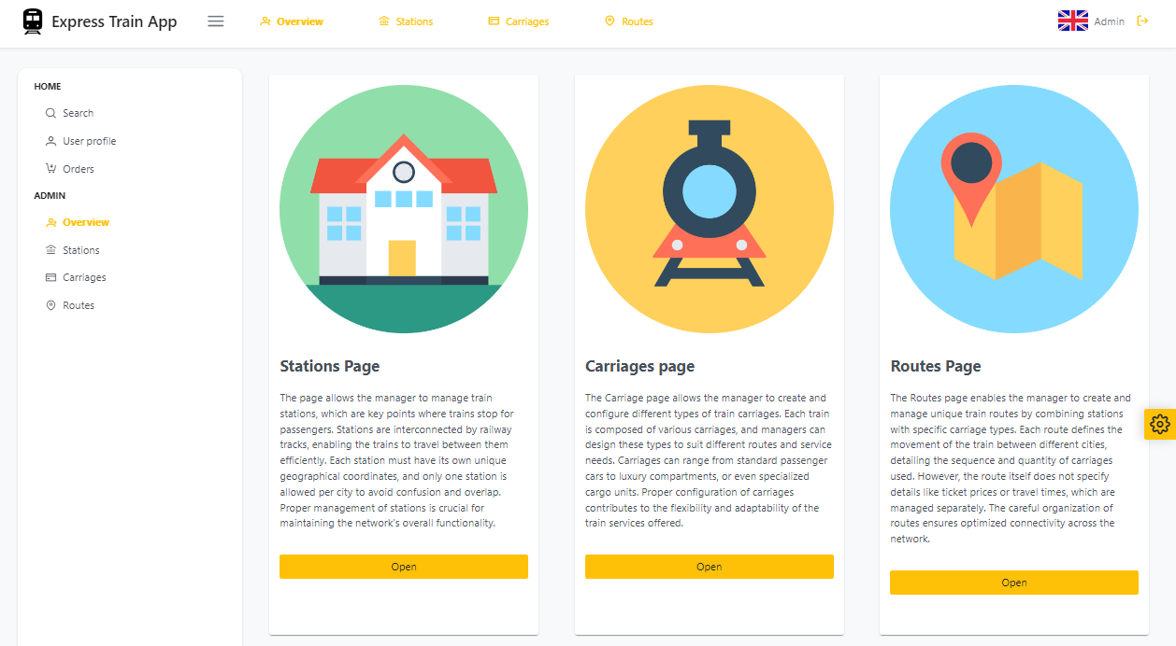
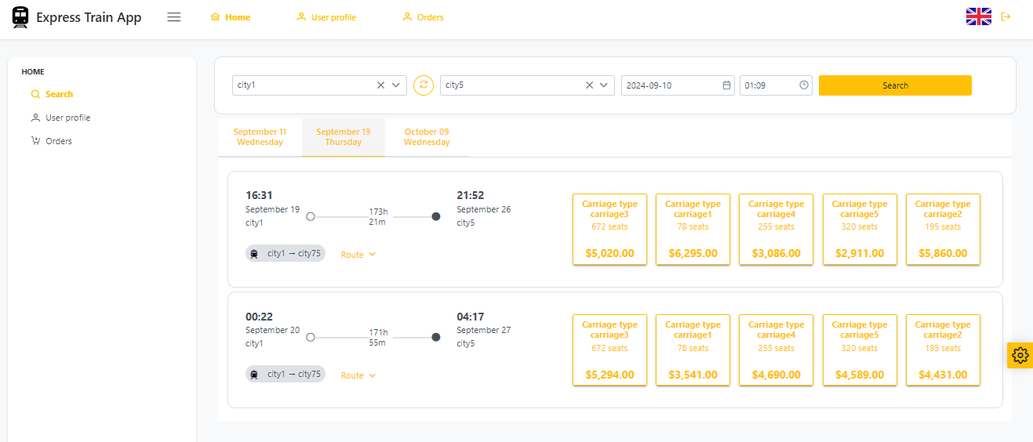
Project overview
The project is a comprehensive train ticket booking system designed to facilitate the management and reservation of train journeys. It provides users with an intuitive platform to search for rides, view detailed trip information, and book seats. Additionally, users can also cancel their reservations.
The app is accessible not only on desktop but also on tablets and mobile devices, ensuring a seamless experience across all platforms.
The system also supports various user roles, including regular users and managers, each with distinct functionalities. Administrators can manage train cars, stops, routes, schedules, and pricing, as well as handle the seat reservations of other users.
Notes:
AUTHOR: TATSIANA
TEXT:
The project is a comprehensive train ticket booking system designed to facilitate the management and reservation of train journeys. It provides users with an intuitive platform to search for rides, view detailed trip information, and book seats. Additionally, users can also cancel their reservations.
The app is accessible not only on desktop but also on tablets and mobile devices, ensuring a seamless experience across all platforms.
The system also supports various user roles, including regular users and managers, each with distinct functionalities. Administrators can manage train cars, stops, routes, schedules, and pricing, as well as handle the seat reservations of other users.

Slide 5
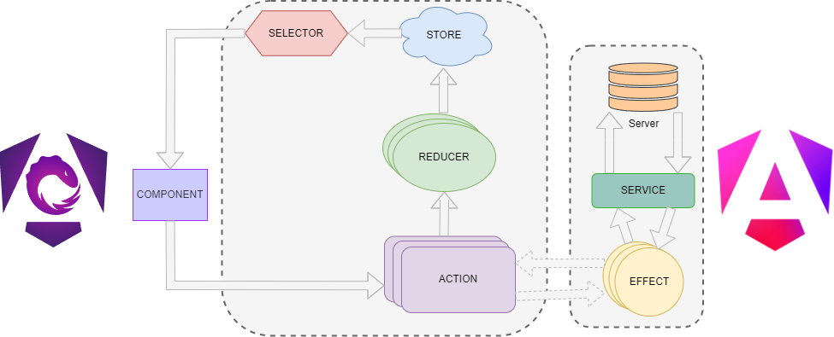
Architecture

Slide 6
Technical Details
Frontend Framework: Angular 18
Backend: Version 11 of `@planess/train-a-backend`
An Angular wrapper for the Leaflet map library: @asymmetrik/ngx-leaflet
A set of libraries for state management in applications: @ngrx/effects, @ngrx/operators, @ngrx/store, @ngrx/store-devtools
Libraries for managing translations and asynchronously loading localization files:@ngx-translate/core, @ngx-translate/http-loader
A set of ESLint plugins for checking Angular code and templates for compliance with standards: @angular-eslint/eslint-plugin, @angular-eslint/eslint-plugin-template, @angular-eslint/template-parser
A tool for setting up Git hooks: husky
A framework for testing JavaScript and TypeScript code: jest, jest-preset-angular
A tool for automatic code formatting: prettier

Slide 7
Technical description
Lazy loading: Modules are loaded on demand, reducing the initial load time of the application.
Guards: Guards are used to protect routes and check access permissions before loading.
State Management: Use Angular services and state management libraries to handle application state and data flow.
Routing: Implement Angular routing to handle navigation between different pages.
Git Hooks with Husky: To automate code checks before commits
Code Style and Linting: The project maintains code quality and style using ESLint and Prettier
Component-Based Architecture: Angular applications are organized around components, which encapsulate both the logic and view templates.
Internationalization (i18n): Asynchronous loading of translations and Language switching
Interactive Maps with Leaflet: Interactive maps and Flexible customization.
User Interface with PrimeNG: Rich components, CSS utilities for building flexible and responsive layouts.
Testing: The project uses Jest for testing components and services

Slide 8
Functionality Demonstration (SignIn/SignUp)

Slide 9
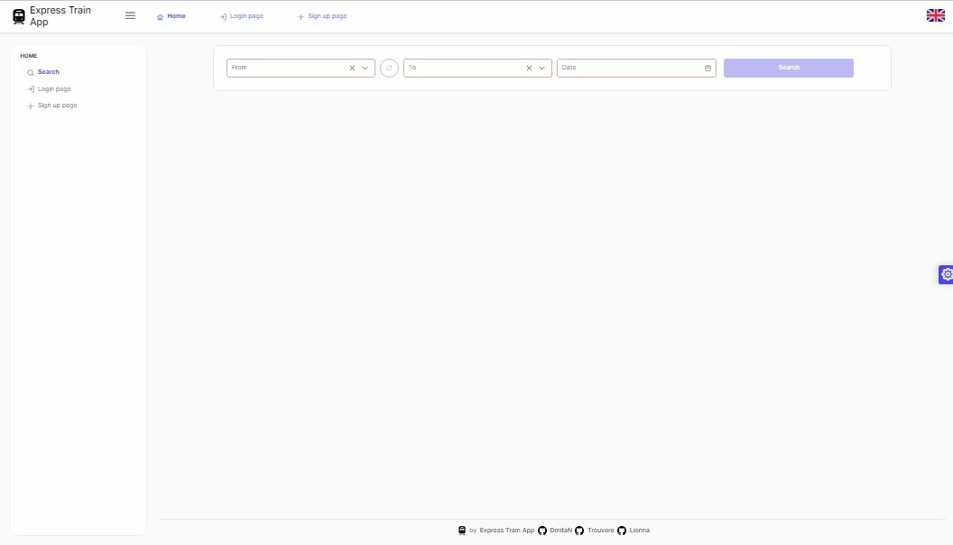
Functionality Demonstration (Search Page)

Slide 10
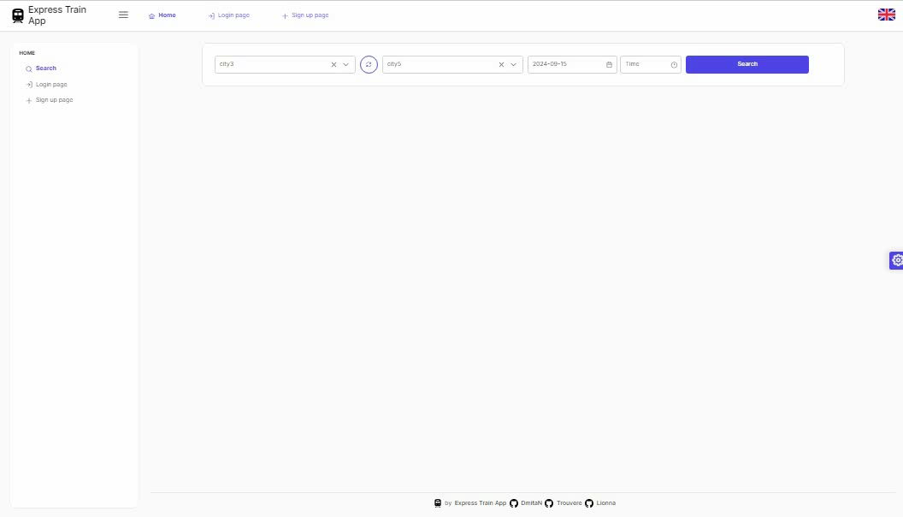
Functionality Demonstration (Profile Page)

Slide 11
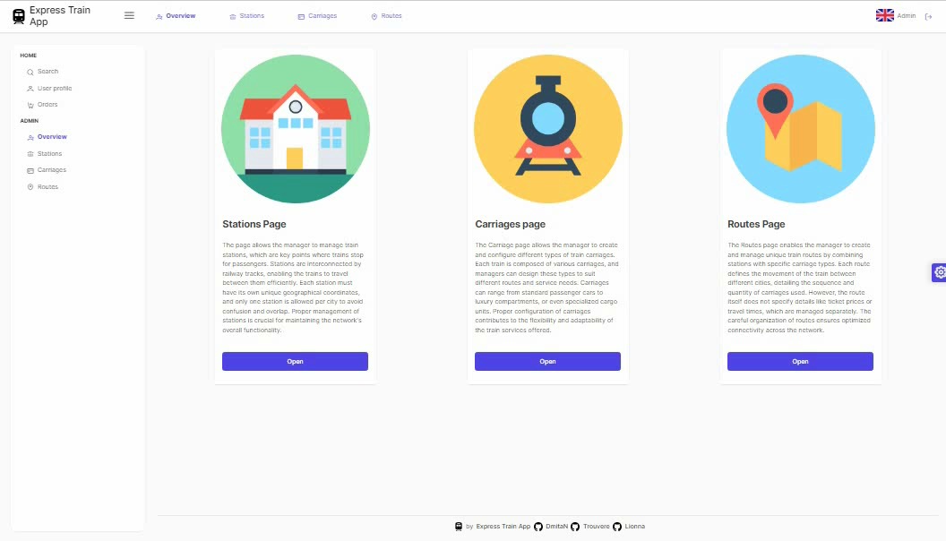
Functionality Demonstration (Carriages Page)

Slide 12
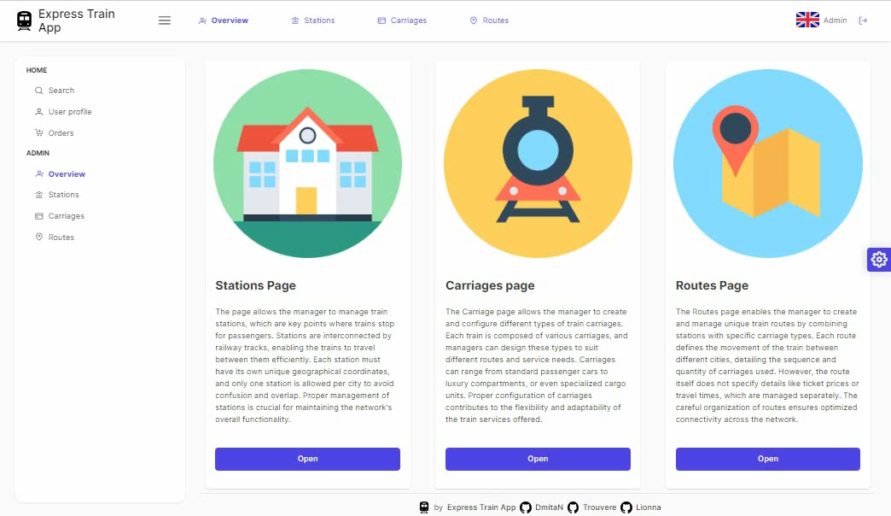
Functionality Demonstration (Stations Page)

Slide 13
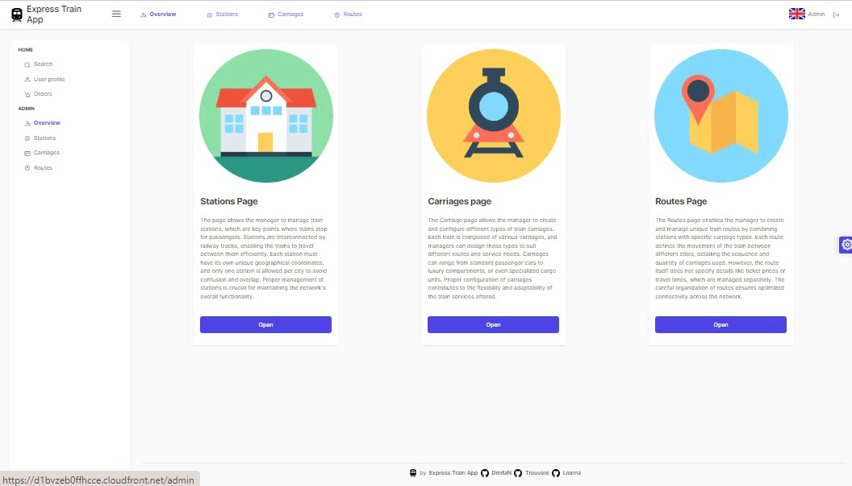
Functionality Demonstration (Routes Page)

Slide 14
Challenges and Solutions
During the development process, the team faced several challenges:
Conflicting Documentation Criteria: At times, the criteria outlined in the documentation were inconsistent or contradictory, making it difficult to align development efforts with the specified requirements.
Solution: The team conducted regular reviews of the documentation and worked closely each other to clarify ambiguities and resolve conflicts, ensuring the development stayed on track with a unified understanding of the project goals.
Technical Issues: Complex technical problems arose, such as optimizing the application's performance and managing state efficiently.
Solution: DmitaN (the Tech Lead) and Trouvere (the Senior Developer), focused on resolving these technical issues by implementing advanced Angular techniques and optimizing state management with NgRx. Lionna was doing manual functional testing.
Component Integration: Ensuring seamless interaction between different components while maintaining state consistency across the application was a challenge.
Solution: DmitaN (the Tech Lead) and Trouvere (the Senior Developer) took the lead in managing the integration of various components with NgRx, facilitating smoother data flow and state management.
Design Consistency: Keeping a consistent and user-friendly design throughout the application while also ensuring responsive and adaptive UI.
Solution: DmitaN and Lionna handled the design and user experience, leading to a cohesive interface design, which was validated through continuous testing.
Visualization Challenges: Visualizing complex data in a clear and meaningful way.
Solution: DmitaN and Lionna was responsible for system visualization and utilized modern libraries to create dynamic and interactive visual representations.
Notes:
AUTHOR: TATSIANA
TEXT:
During the development of the Express Train App, our team faced several challenges:
First, conflicting documentation criteria made it difficult to align development efforts. We conducted regular reviews and collaborated closely to clarify ambiguities and resolve conflicts, keeping the project on track.
Next, we encountered technical issues like optimizing performance and managing state. DmitaN, our Tech Lead, and Trouvere, our Senior Developer, tackled these problems using advanced Angular techniques and NgRx.
Component integration was also challenging, requiring seamless interaction between different parts of the application. DmitaN and Trouvere managed this with Redux to maintain consistent data flow.
Maintaining design consistency and ensuring a responsive UI was another focus. DmitaN and Lionna collaborated to create a cohesive, user-friendly interface through continuous testing.
Lastly, visualizing complex data was essential. DmitaN and Lionna used modern libraries to create dynamic and interactive visualizations.
Through teamwork and innovation, we overcame these challenges to deliver a robust app.

Slide 15
Conclusion
The project provided the team with valuable experience in Angular development, state management with NgRx, and collaboration using modern tools like GitHub and Discord. Team members enhanced their skills in managing technical issues, integrating various components, and maintaining a positive team atmosphere. The experience also deepened their understanding of frontend development, design principles, and visualization techniques.
Enhanced Testing | Expand the testing suite by integrating additional automated tests, such as end-to-end testing using Cypress.
Performance Optimization | Further optimize the application's performance by refining the use of Angular's Change Detection Strategy.
Additional Features | Introduce new features, such as advanced search and filtering options, and support for more complex fare structures
Booking Flexibility | Expand the booking capability to allow users to reserve multiple tickets in a single transaction. Currently, the system supports the reservation of only one ticket per booking. This enhancement will improve user convenience by enabling the selection of multiple seats at once, streamlining group bookings, and offering more flexible travel arrangements
Backend API Optimization | Improve the backend API by adding functionality for paginated data retrieval, enhancing performance and scalability, especially for large datasets
Payment Integration | Implement a comprehensive payment system to facilitate secure and seamless transactions directly within the application
Authorization System Improvements | Upgrade the authorization system to strengthen security, streamline user management, and enhance access control for different user roles
Error Handling and Display | Improve the handling and display of backend errors. This includes ensuring that errors from the backend are correctly captured and presented to users in a clear and actionable format. Enhanced error messages will help users understand what went wrong and how to address any issues, improving overall user experience and system reliability
Notes:
AUTHOR: TATSIANA
TEXT:
The development of the Express Train App provided the team with valuable experience in Angular development, state management with NgRx, and collaboration using modern tools like GitHub and Discord. Team members enhanced their skills in handling technical challenges, integrating various components, and maintaining a positive team atmosphere. This experience deepened their understanding of frontend development, design principles, and visualization techniques.
Further Development of the Project Includes:
Enhanced Testing: Integration of additional automated tests, including end-to-end testing using Cypress.
Backend API Optimization: Improvement of the backend API by adding functionality for paginated data retrieval to enhance performance and scalability.
New Features: Introduction of advanced search and filtering options, along with support for more complex fare structures.
Performance Optimization: Further optimization of the application's performance by refining Angular's Change Detection Strategy.
Booking Flexibility: Expansion of booking capabilities to allow users to reserve multiple tickets in a single transaction, enhancing convenience and streamlining group bookings.
Payment Integration: Implementation of a secure and seamless payment system directly within the application.
Authorization System Improvements: Strengthening of the security, user management, and access control for different user roles.
Error Handling and Display: Improved handling and display of backend errors to ensure that errors are presented to users in a clear, actionable format, enhancing overall user experience and system reliability.

